Slide 1

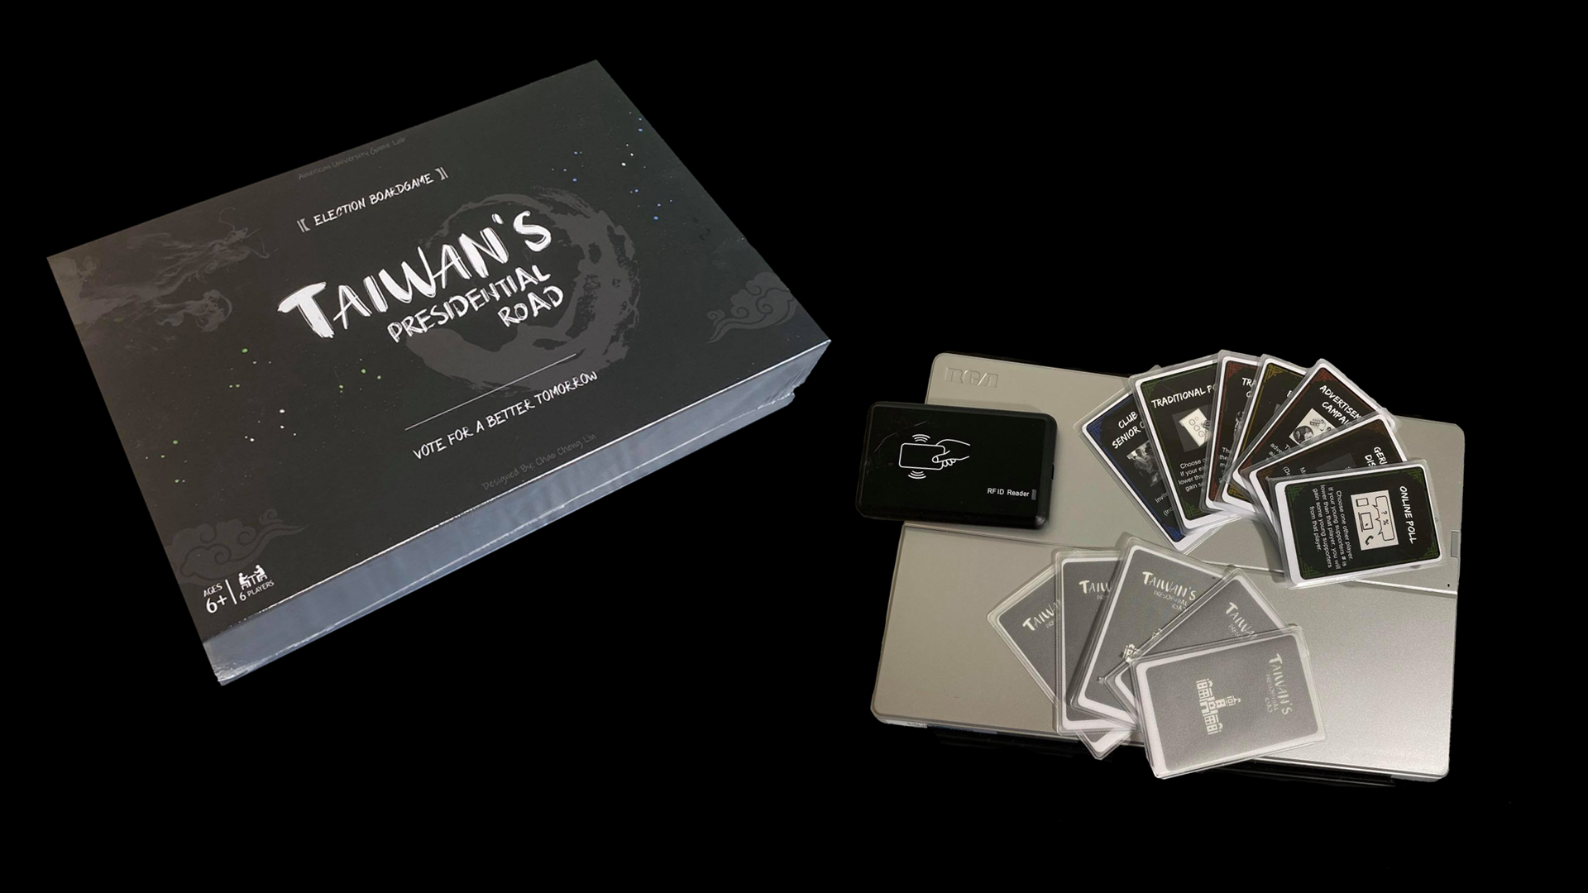
Capstone
Caho Cheng Lin(Ken)
American university
Game Lab

Slide 2
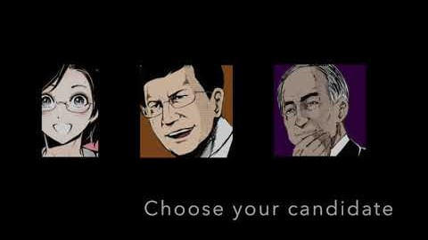

Slide 3
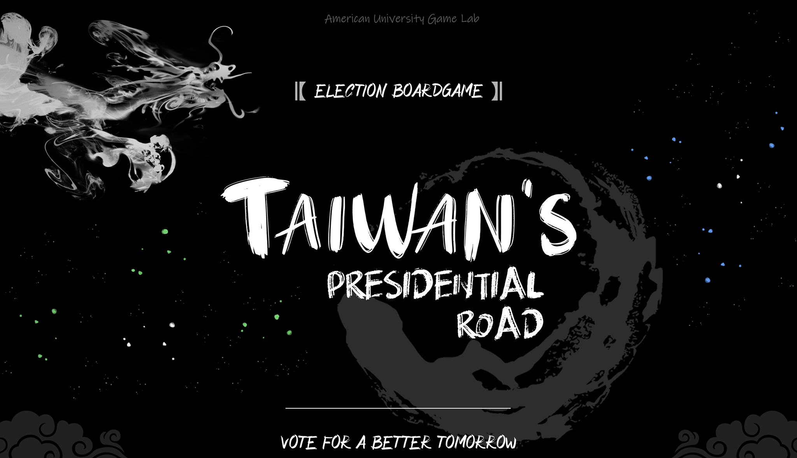
Vote For A Better Tomorrow

Slide 4
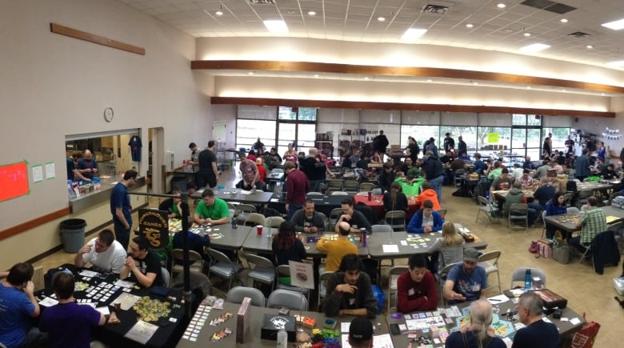

Why
Combine
TAIWAN’s PRESIDENTIAL ROAD
Image from @gamefragger.com @cbc.ca

Slide 5
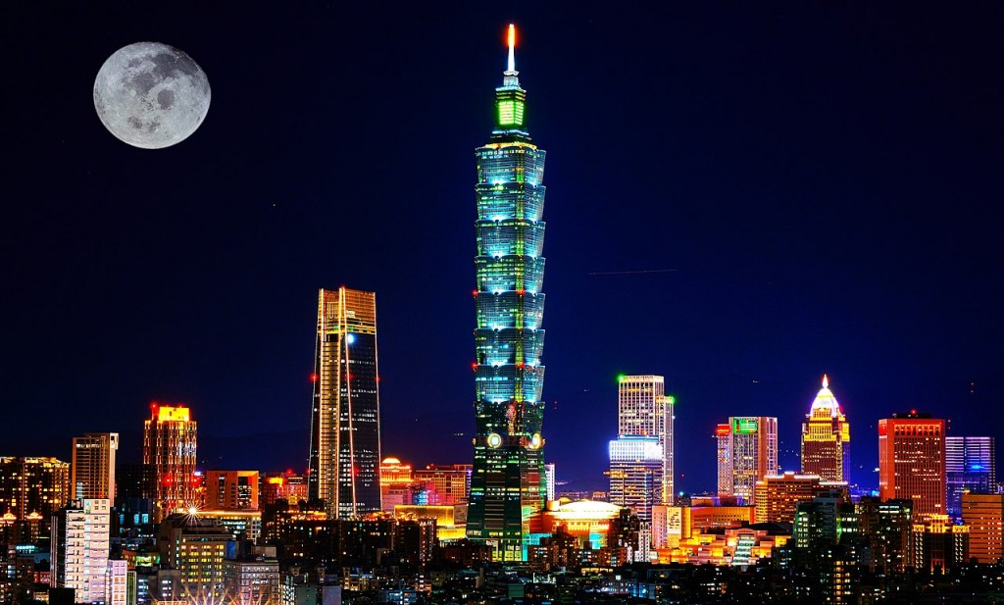
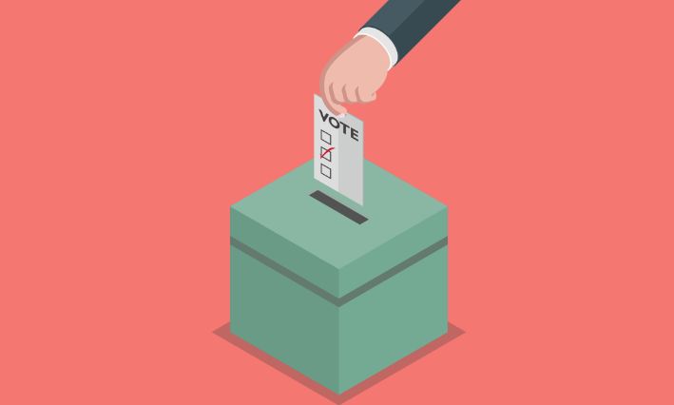

Goal
2008 presidential elections voter turnout
Did not vote
38%
50%
12%
Adult who voted
Youths who voted
Image from @bbc.com @eng.taiwan.net.tw

Slide 6

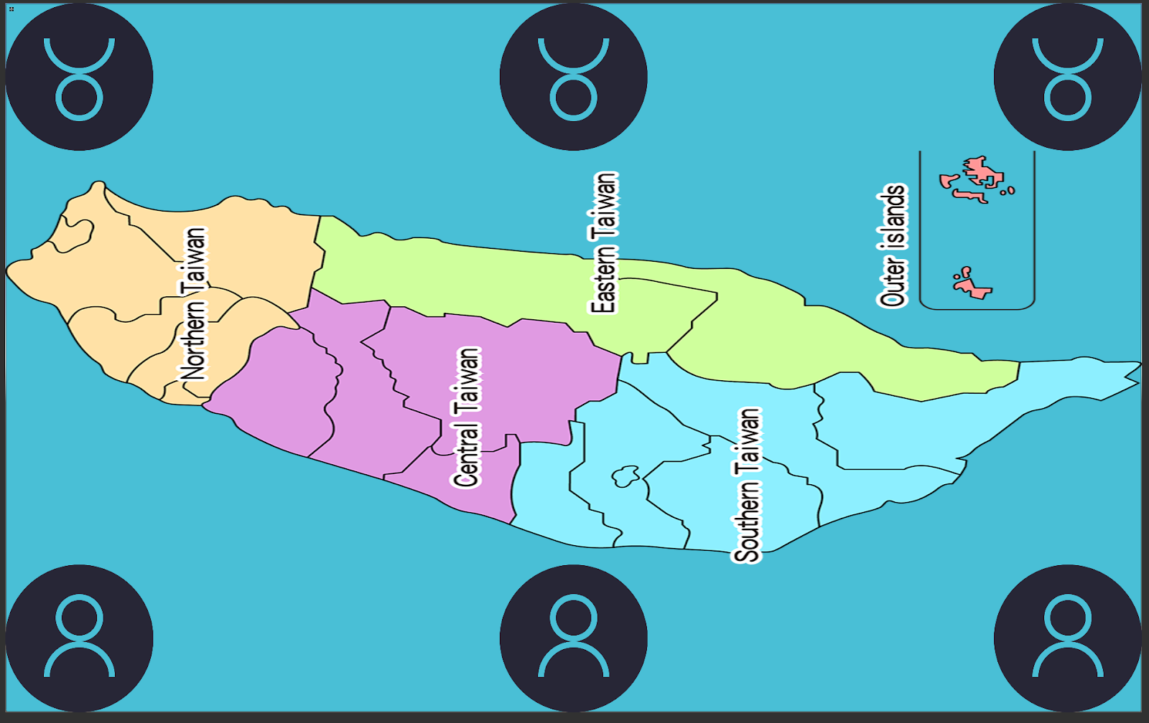
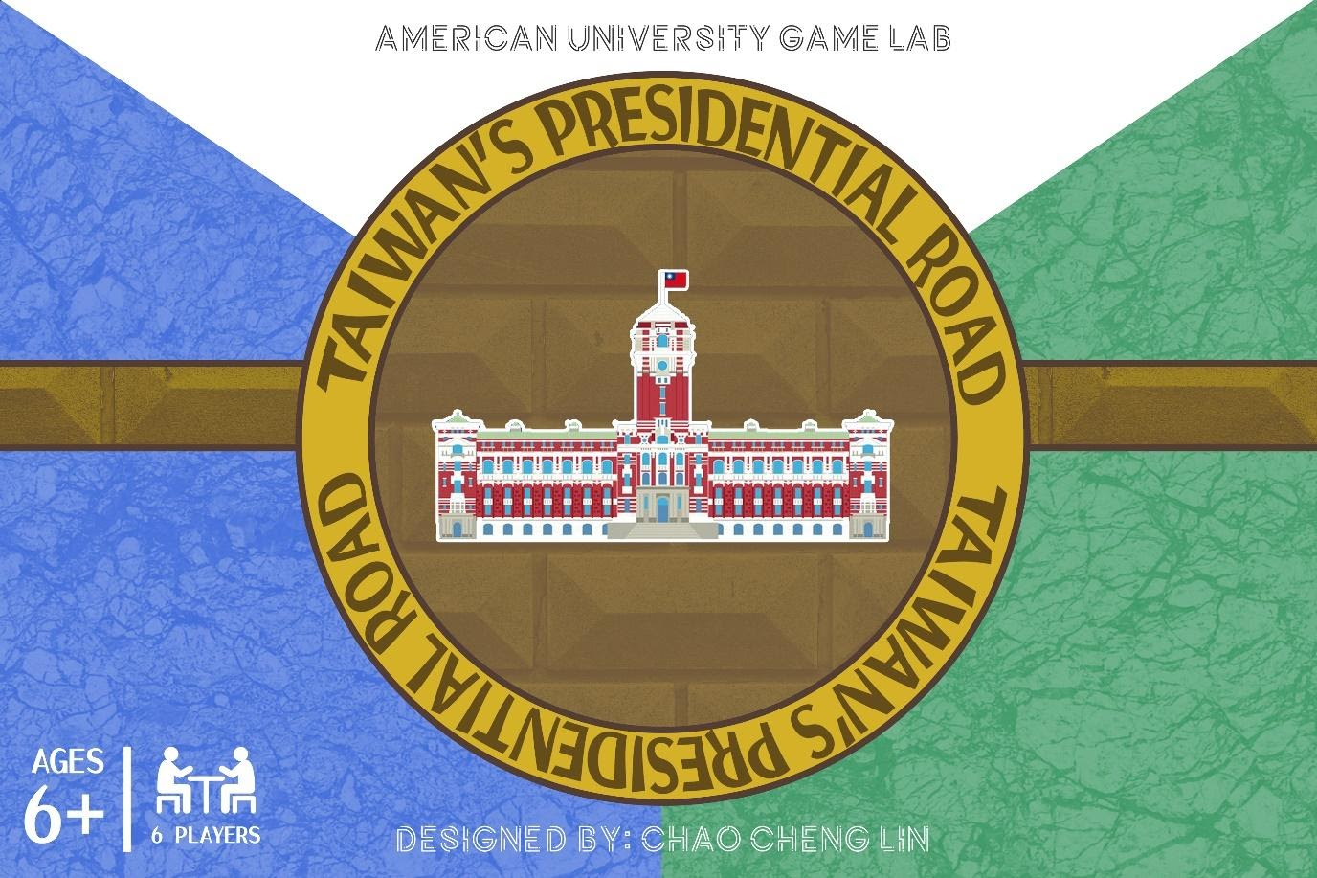
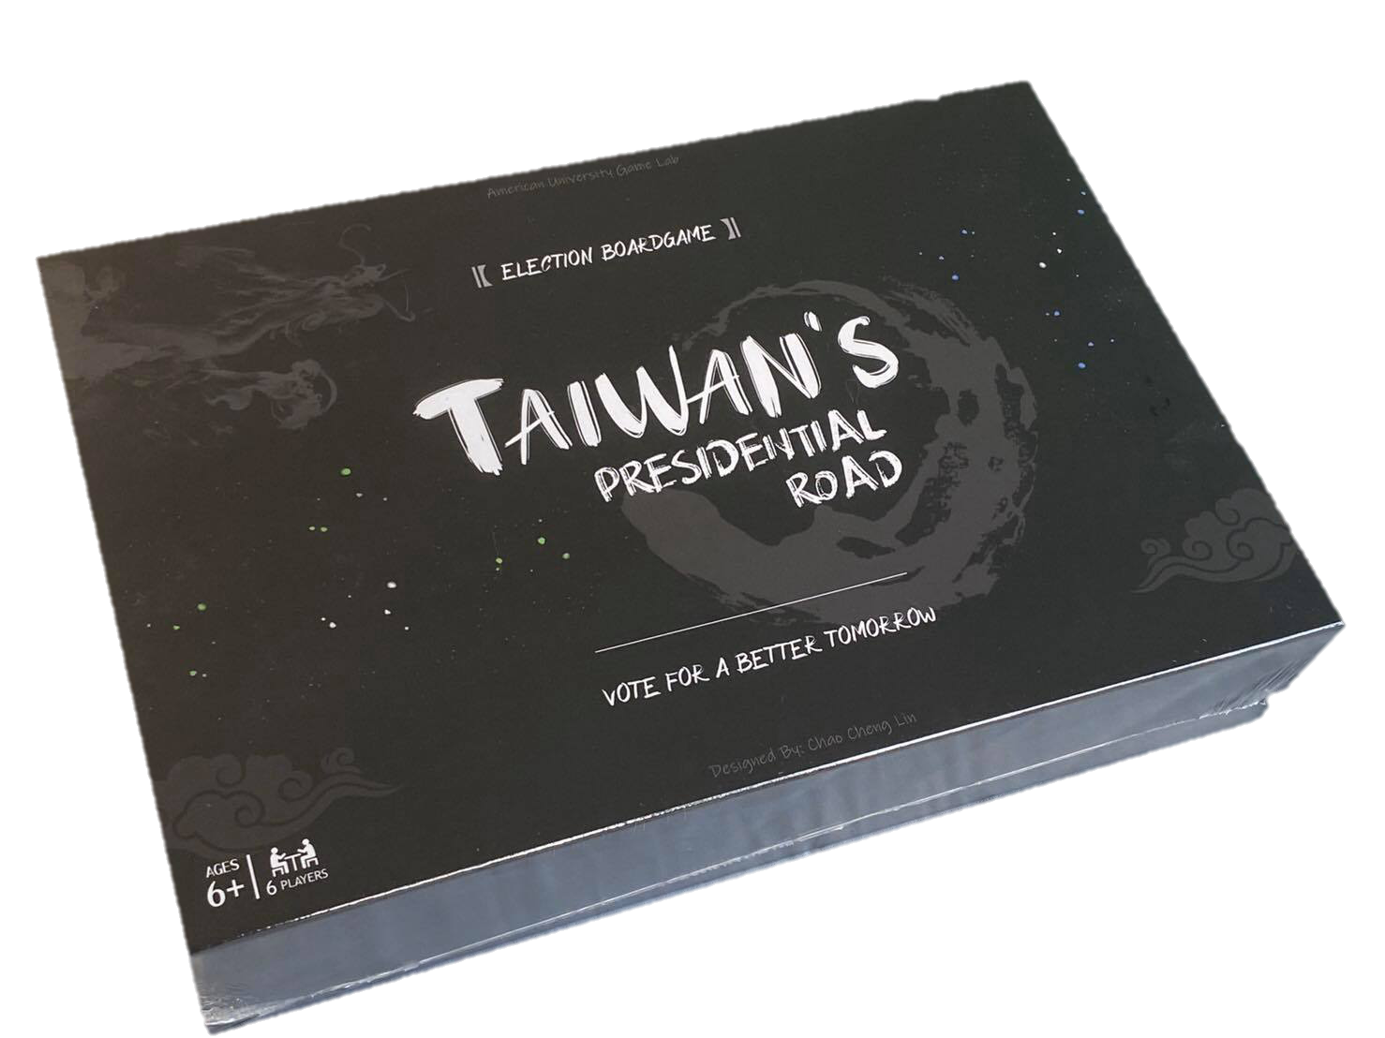
Development process

Slide 7
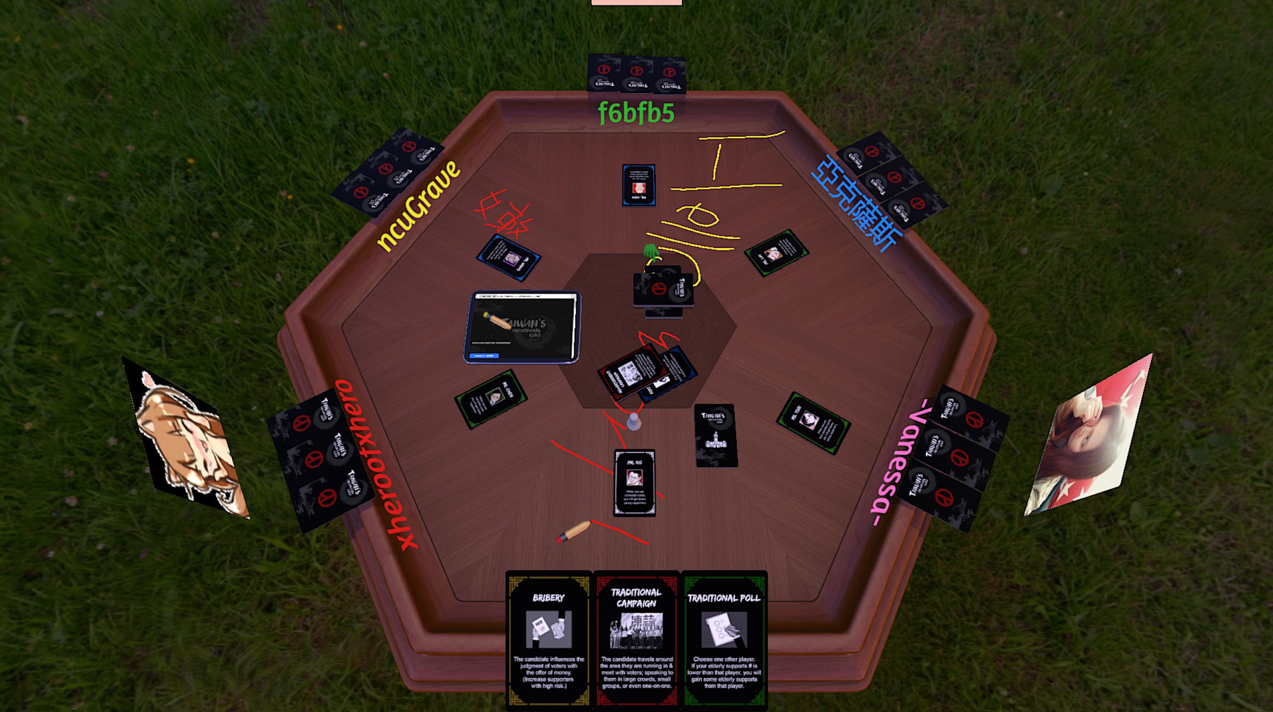
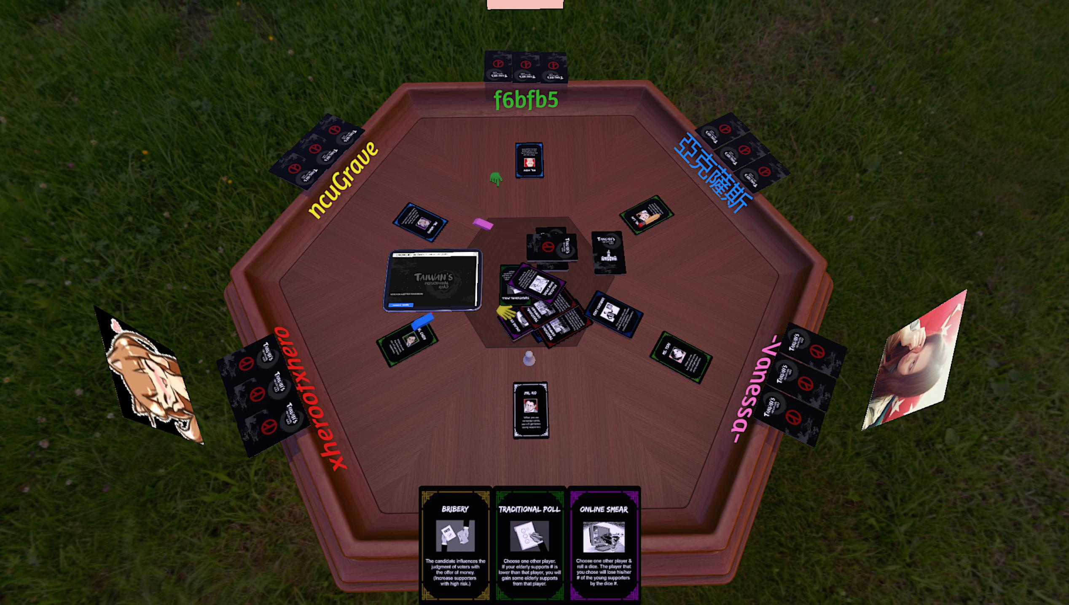
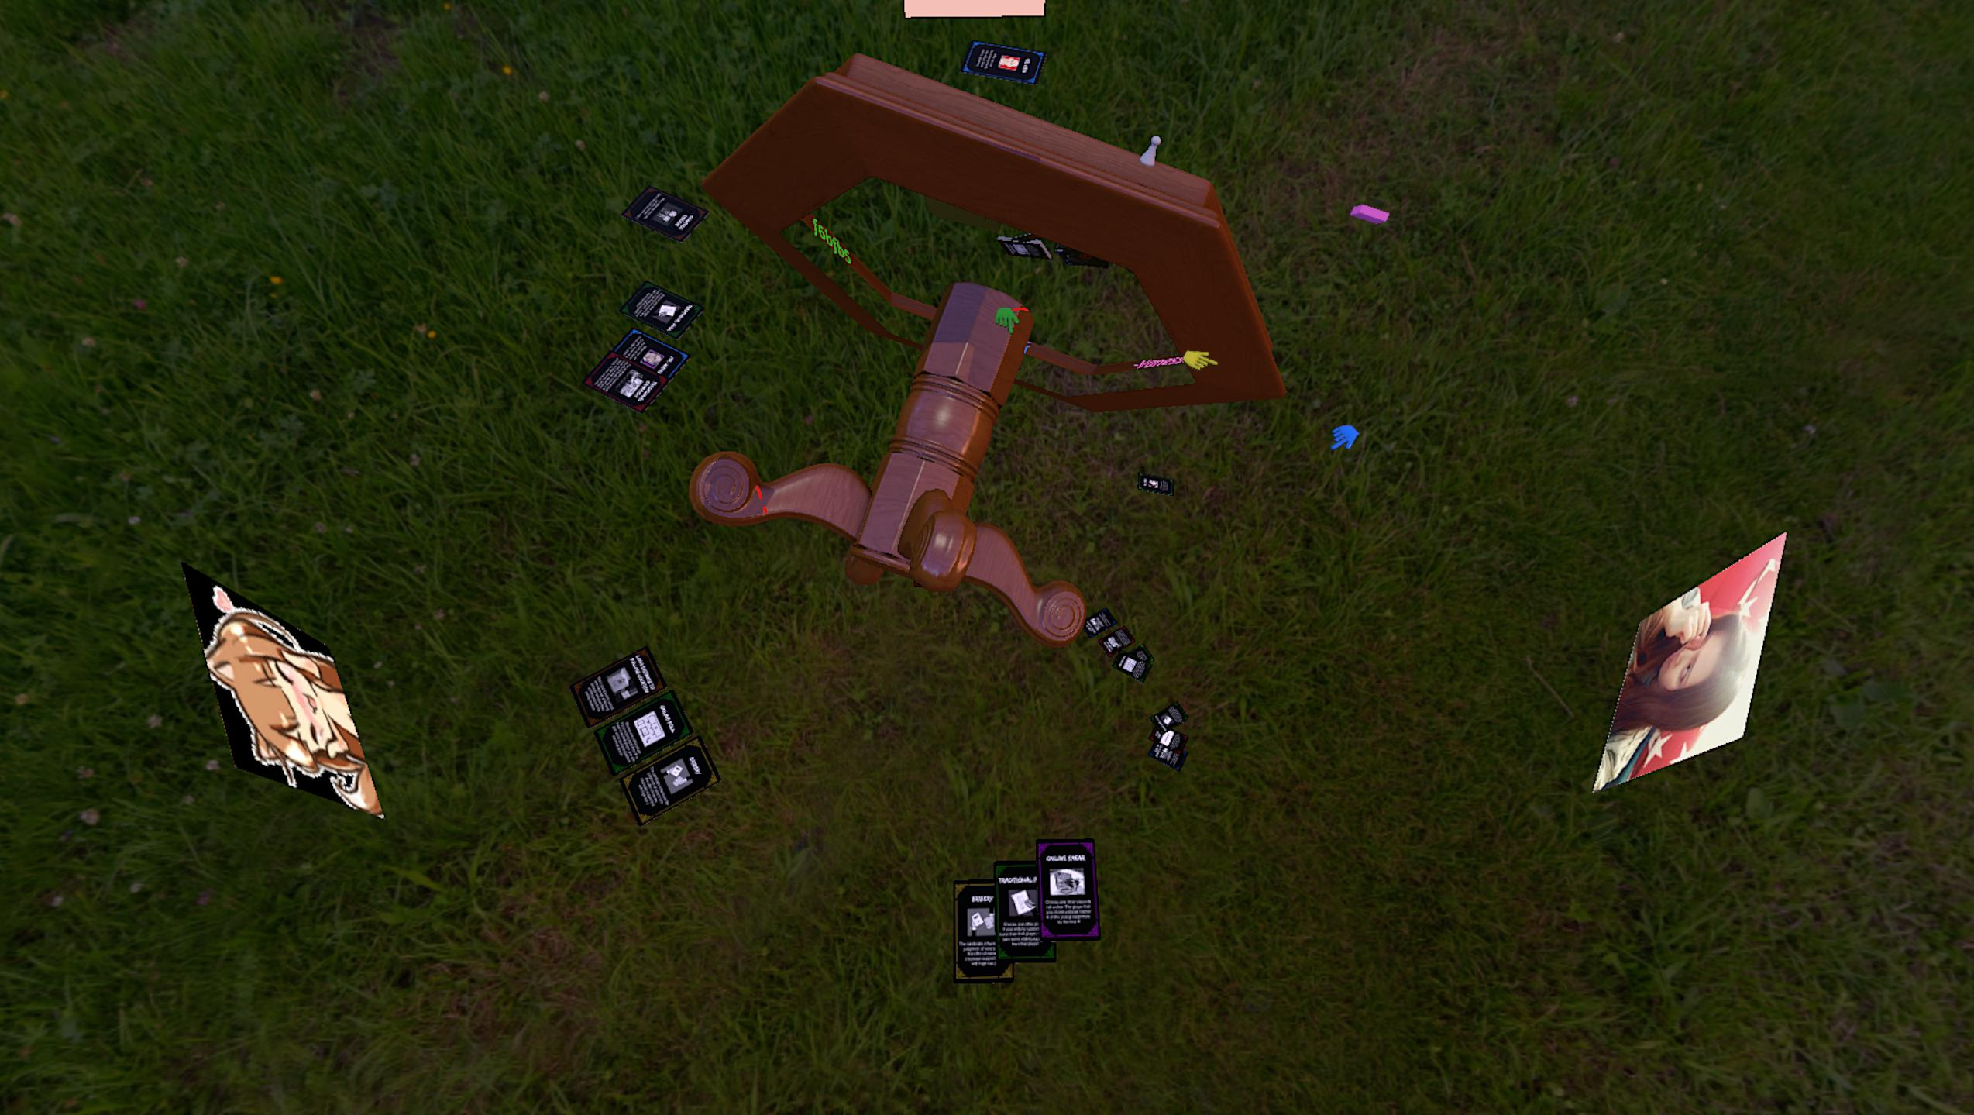
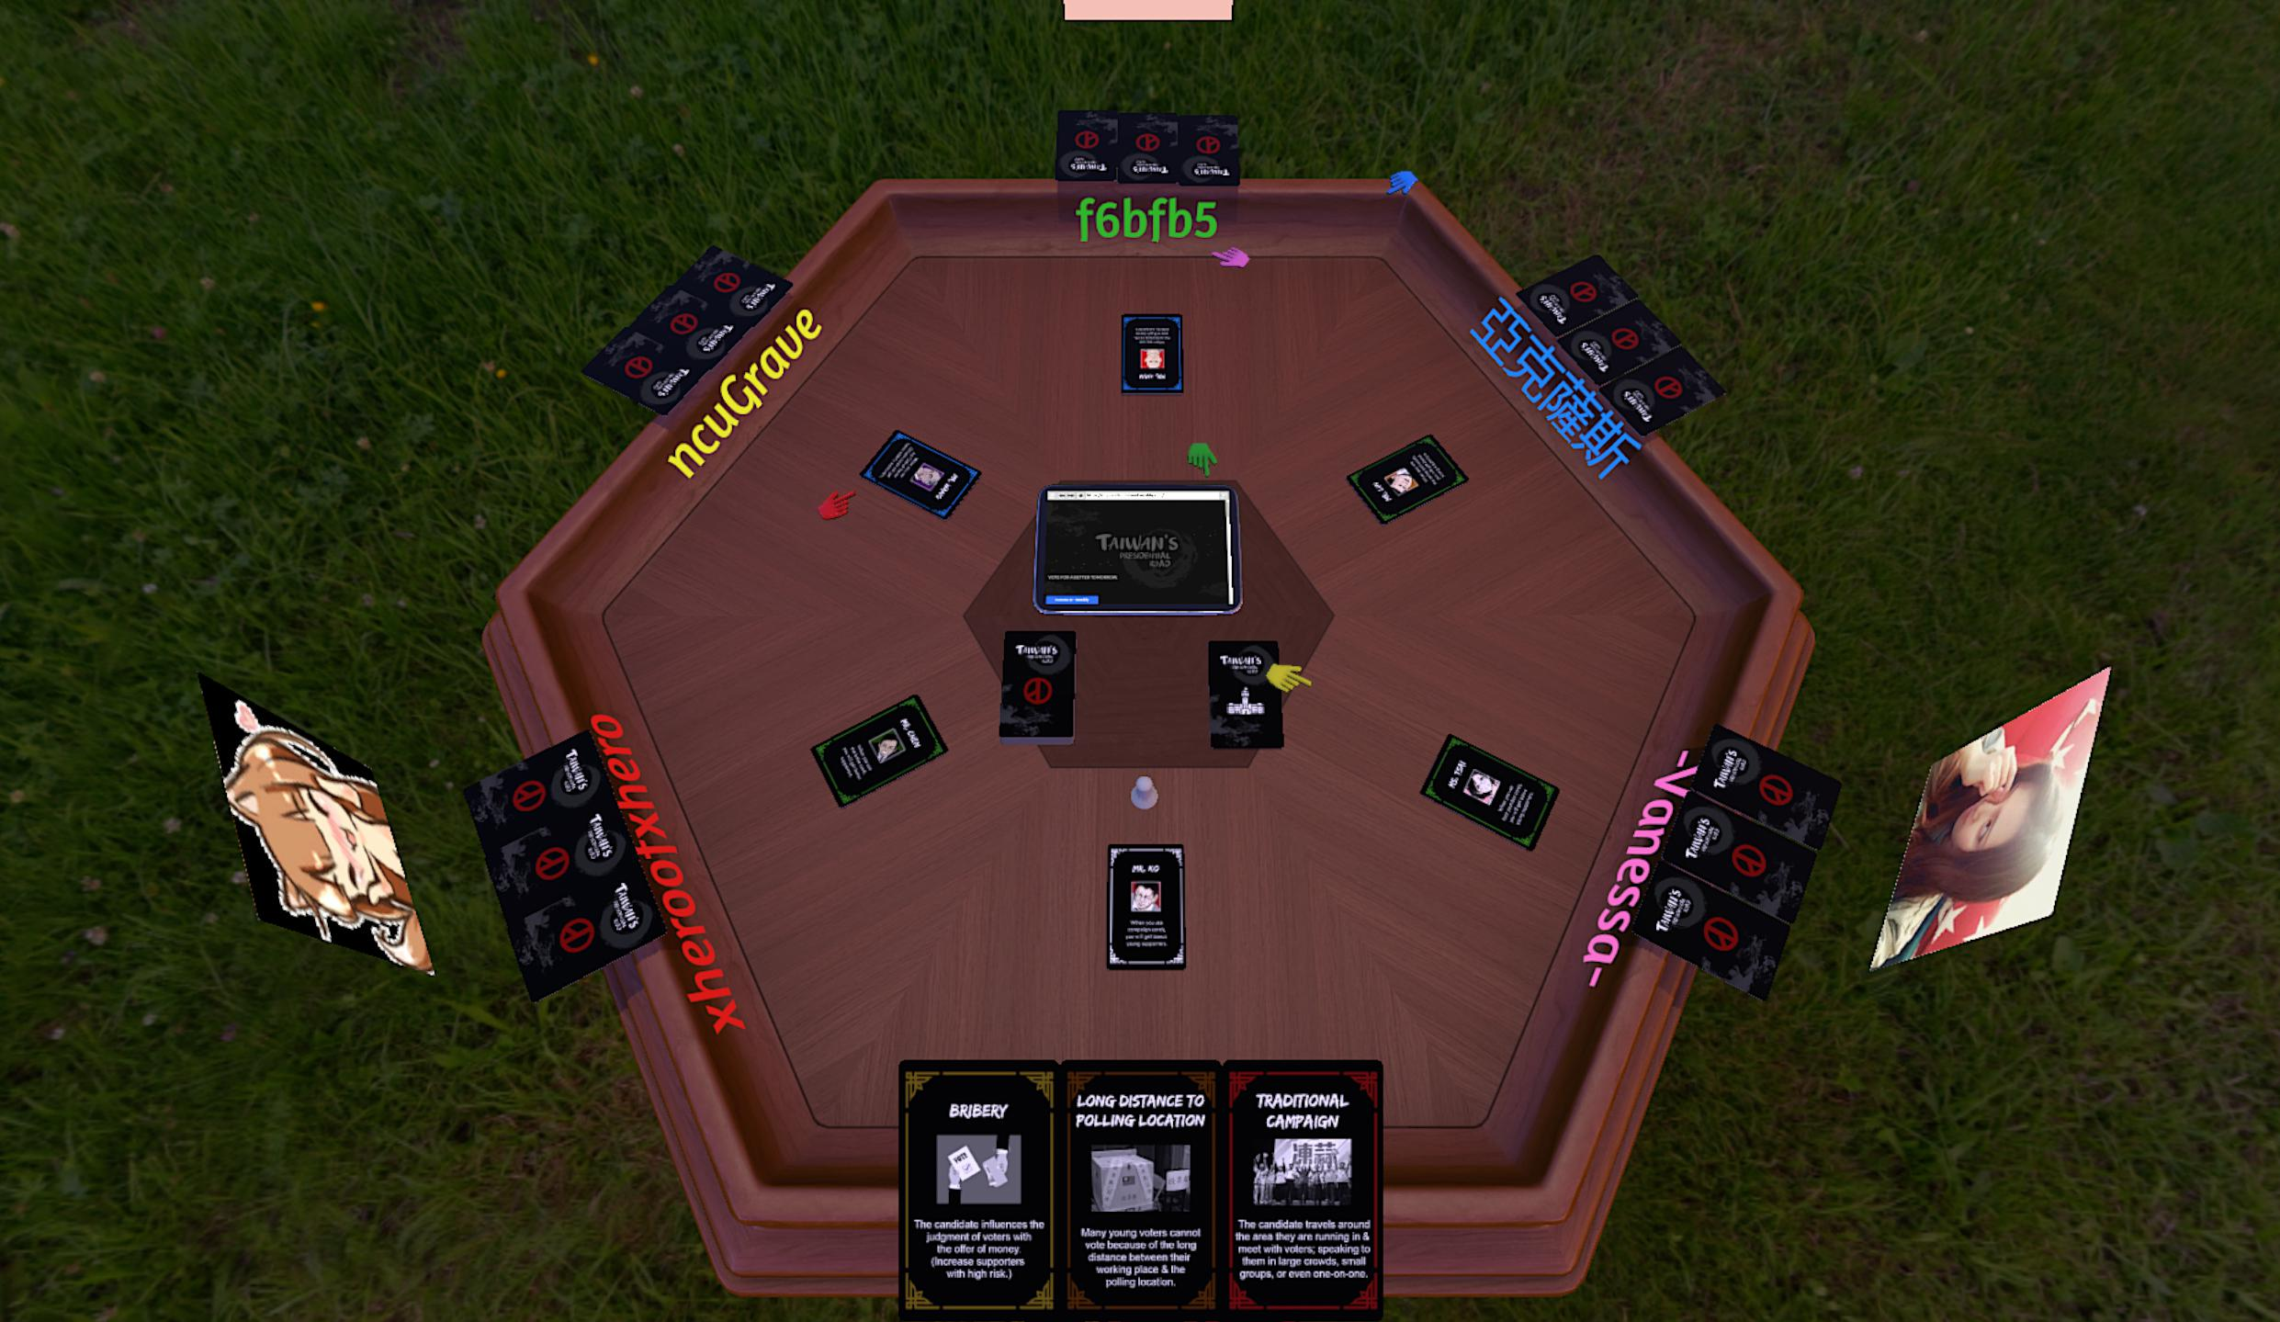

playtesting
Image from @tabletop simulator @steam

Slide 8
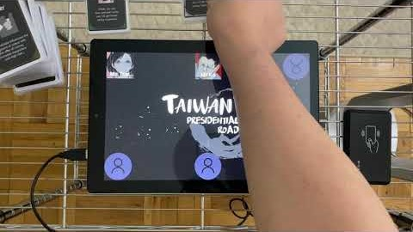
Demo

Slide 9
FUTURE
Augmented Reality(AR)
Add more characters, cards.
If possible, Find some donations from kickstarter.com/

Slide 10
Conclusion
Website: https://twpresidentialroad.weebly.com/
trailer: https://www.youtube.com/watch?v=LAynyYvRzqo
Demo: https://www.youtube.com/watch?v=SDi-aN3BYpU
Documentation and APP: https://github.com/lin60102/TaiwanPresidentialRoad

Slide 11


